Slide 1
Derivatives.
Important concept.
Simple to grasp in Kotlin.
Breandan Considine
@breandan

Slide 2
What are derivatives?
How do derivatives work?
What can be derived?
How can I derive in Kotlin?
What’s the difference?

Slide 3
What are derivatives?

Slide 4
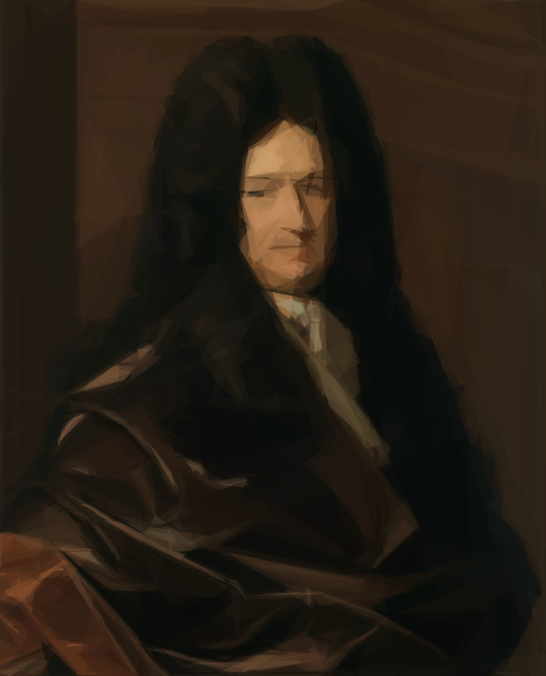
Leibniz: derivatives as rate of change
“It is unworthy of excellent [minds] to lose hours like slaves in the labor of calculation which could safely be relegated to anyone else if machines were used.”
-Gottfried Wilhelm Leibniz
https://en.wikipedia.org/wiki/Gottfried_Wilhelm_Leibniz

Slide 5
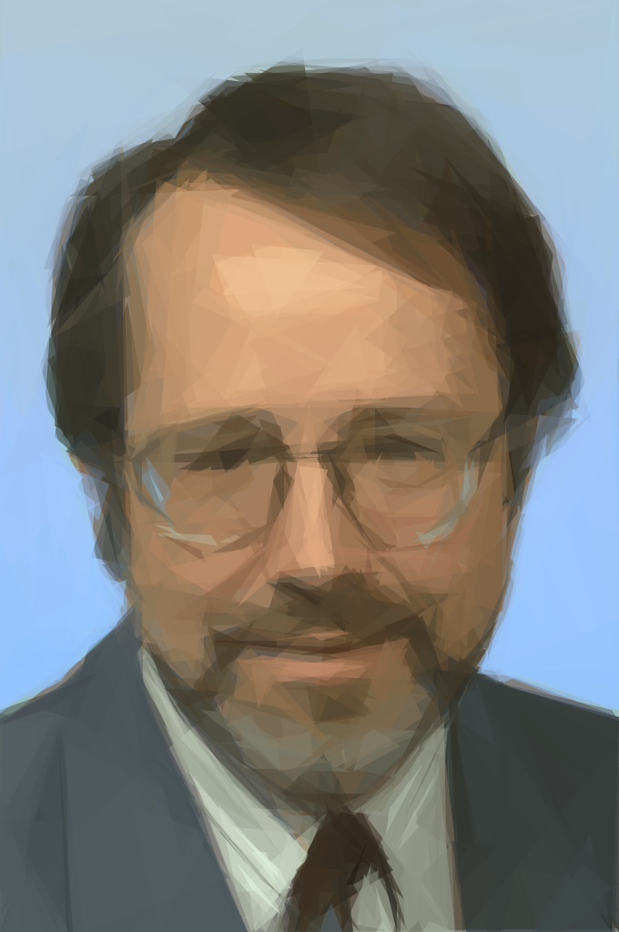
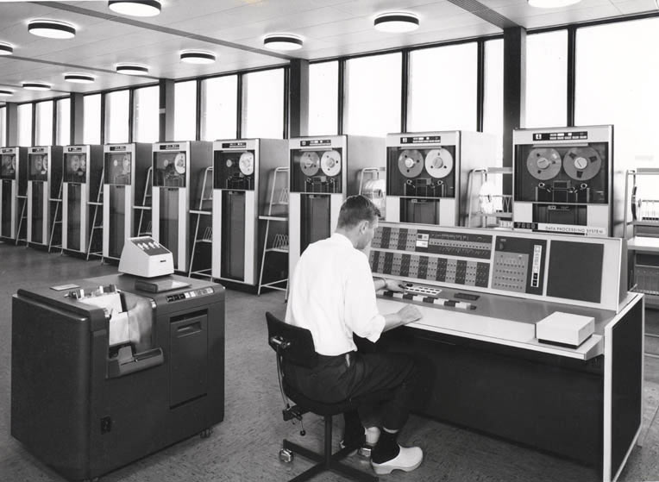

Linnainmaa: Reverse mode differentiation
Seppo Linnainmaa
http://www.helbig.dk/neucc/index.htm

Slide 6
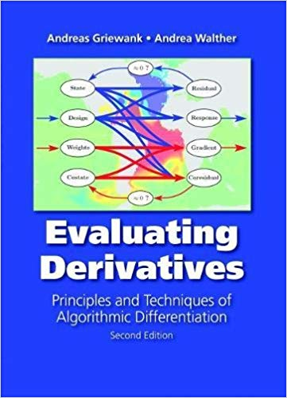
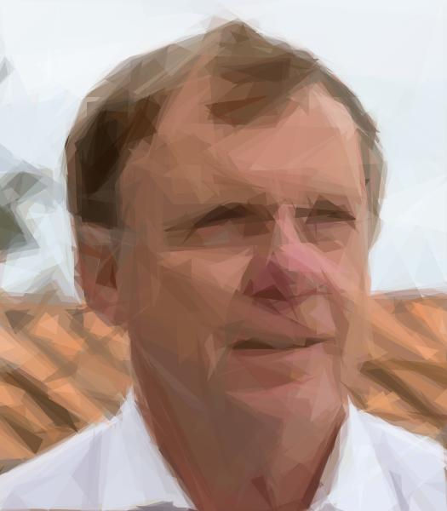
Griewank: Algorithmic differentiation
Andreas Griewank

Slide 7
1. An algorithm for minimizing any function

Slide 8
1. An algorithm for minimizing any function
tailrec fun <I, O : Comparable<O>> minimize( fn: (I) -> (O), min: I, budget: Int): I =

Slide 9
1. An algorithm for minimizing any function
tailrec fun <I, O : Comparable<O>> minimize( fn: (I) -> (O), min: I, budget: Int): I = if (budget <= 0) min else minimize(fn, sample<I>().let { input -> if (fn(input) < fn(min)) input else min }, budget - 1)

Slide 10
1. An algorithm for minimizing any function
tailrec fun <I, O : Comparable<O>> minimize( fn: (I) -> (O), min: I, budget: Int): I = if (budget <= 0) min else minimize(fn, sample<I>().let { input -> if (fn(input) < fn(min)) input else min }, budget - 1) fun <I> sample(): I = TODO()

Slide 11
2. Better algorithm (but more restrictive)

Slide 12
2. Better algorithm (but more restrictive)
interface Metric<T : Metric<T>> : Comparable<T> { operator fun plus(t: T): T operator fun minus(t: T): T }

Slide 13
2. Better algorithm (but more restrictive)
interface Metric<T : Metric<T>> : Comparable<T> { operator fun plus(t: T): T operator fun minus(t: T): T } tailrec fun <I, O : Metric<O>> minimizeMetric( fn: (I) -> (O), min: I, budget: Int): I = if (budget <= 0) min else minimizeMetric(fn, wiggle(min).filter { fn(it) < fn(min) } .maxBy { fn(min) - fn(it) } ?: min, budget - 1)

Slide 14
2. Better algorithm (but more restrictive)
interface Metric<T : Metric<T>> : Comparable<T> { operator fun plus(t: T): T operator fun minus(t: T): T } tailrec fun <I, O : Metric<O>> minimizeMetric( fn: (I) -> (O), min: I, budget: Int): I = if (budget <= 0) min else minimizeMetric(fn, wiggle(min).filter { fn(it) < fn(min) } .maxBy { fn(min) - fn(it) } ?: min, budget - 1) fun <I> wiggle(min: I): Sequence<I> = TODO()
Notes:
Crucially, depends on the dimensionality of the input.

Slide 15
3. Still better algorithm (even more restrictive)

Slide 16
3. Still better algorithm (even more restrictive)
interface Field<T : Field<T>> : Metric<T> { operator fun times(t: T): T operator fun div(t: T): T }

Slide 17
3. Still better algorithm (even more restrictive)
interface Field<T : Field<T>> : Metric<T> { operator fun times(t: T): T operator fun div(t: T): T } tailrec fun <T: Field<T>> fieldMinimize( fn: (T) -> (T), a: T, min: T, budget: Int): T = if(budget <= 0) min else minimizeField(fn, a, min - (fn(min + a) - fn(min)) / a, budget – 1)

Slide 18
3. Still better algorithm (even more restrictive)
interface Field<T : Field<T>> : Metric<T> { operator fun times(t: T): T operator fun div(t: T): T } tailrec fun <T: Field<T>> fieldMinimize( fn: (T) -> (T), a: T, min: T, budget: Int): T = if(budget <= 0) min else minimizeField(fn, a, min - (fn(min + a) - fn(min)) / a, budget – 1)

Slide 19
4. So what’s the problem?

Slide 20
4. So what’s the problem?
fn: (T) -> (T)

Slide 21
4. So what’s the problem?
fn: (T) -> (T)
fn: (T, T) -> (T)

Slide 22
4. So what’s the problem?
fn: (T) -> (T)
fn: (T, T) -> (T)
fn: (T, T, T) -> (T)

Slide 23
4. So what’s the problem?
fn: (T) -> (T)
fn: (T, T) -> (T)
fn: (T, T, T) -> (T)

Slide 24
4. So what’s the problem?
fn: (T) -> (T)
fn: (T, T) -> (T)
fn: (T, T, T) -> (T)
fn: (T) -> Pair<T, T>
fn: (T, T) -> Triple<T, T>

Slide 25
4. So what’s the problem?
fn: (T) -> (T)
fn: (T, T) -> (T)
fn: (T, T, T) -> (T)
fn: (T) -> Pair<T, T>
fn: (T, T) -> Triple<T, T>

Slide 26
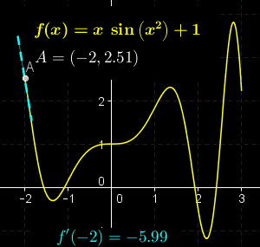
How do derivatives work?

Slide 27
1. Sum rule
Notes:
Note: Evocative of ratio. No actual division involved.
\frac{d}{dx}(l \cdot r) = \frac{dl}{dx}\cdot r + l \cdot \frac{dr}{dx}

Slide 28
2. Product rule
Notes:
\frac{d}{dx}(l \cdot r) = \frac{dl}{dx}\cdot r + l \cdot \frac{dr}{dx}

Slide 29
2. Chain rule
Notes:
\frac{d}{dx}(l \circ r) = \frac{dl}{dr} \cdot \frac{dr}{dx}

Slide 30
2. Chain rule, revisited
“Forward accumulation”:
“Reverse accumulation”:
Notes:
Generalizes to vector functions.
f = l \circ r = l(r(x))
\frac{df}{dx} = \frac{dl}{dr} \cdot \frac{dr}{dx}
\frac{dP}{dp_1} = \frac{dp_k}{dp_{k-1}}\frac{dp_{k-1}}{dp_{k-2}}\frac{dp_{k-2}}{dp_{k-3}}\dots\frac{dp_2}{dp_1}
\frac{dP}{dp_1} = \frac{dp_k}{dp_{k-1}}\left(\frac{dp_{k-1}}{dp_{k-2}}\left(\frac{dp_{k-2}}{dp_{k-3}}\dots\frac{dp_2}{dp_1}\right)\right)
\frac{dP}{dp_1} = \left(\left(\frac{dp_k}{dp_{k-1}}\frac{dp_{k-1}}{dp_{k-2}}\right)\frac{dp_{k-2}}{dp_{k-3}}\right)\dots\frac{dp_2}{dp_1}

Slide 31
Differentiation rules in Kotlin
class D<X: Fun<X>>(val f: Fun<X>): Fun<X>(f) { fun Fun<X>.df(): Fun<X> = when (this) {
is Sum -> left.df() + right.df() is Prod -> left.df() * right + left * right.df()
is Comp -> left.df()(right) * right.df()
} }

Slide 32
Differentiation rules in Kotlin
class D<X: Fun<X>>(val f: Fun<X>): Fun<X>(f) { fun Fun<X>.df(): Fun<X> = when (this) {
is Const -> Zero()
is Var -> One() is Sum -> left.df() + right.df() is Prod -> left.df() * right + left * right.df()
is Comp -> left.df()(right) * right.df()
is D -> f.df() } }

Slide 33
Functions in Kotlin
sealed class Fun<X : Fun<X>>(open val sVars: Set<Var<X>> = emptySet()) : Field<Fun<X>>, (Bindings<X>) -> Fun<X> { constructor(fn: Fun<X>) : this(fn.sVars) constructor(vararg fns: Fun<X>) : this(fns.flatMap { it.sVars }.toSet()) override operator fun plus(addend: Fun<X>): Fun<X> = Sum(this, addend) override operator fun times(multiplicand: Fun<X>): Fun<X> = Prod(this, multiplicand) override operator fun div(divisor: Fun<X>): Fun<X> = this * divisor.pow(-One<X>()) override operator fun invoke(bnds: Bindings<X>): Fun<X> = Composition(this, bnds).run { if (bnds.isReassignmentFree) evaluate else this } open operator fun invoke(): Fun<X> = invoke(Bindings()) open fun d(v1: Var<X>): Fun<X> = Derivative(this, v1) open fun d(v1: Var<X>, v2: Var<X>): Vec<X, D2> =
Vec(Derivative(this, v1), Derivative(this, v2)) open fun d(vararg vars: Var<X>): Map<Var<X>, Fun<X>> =
vars.map { it to Derivative(this, it) }.toMap() }

Slide 34
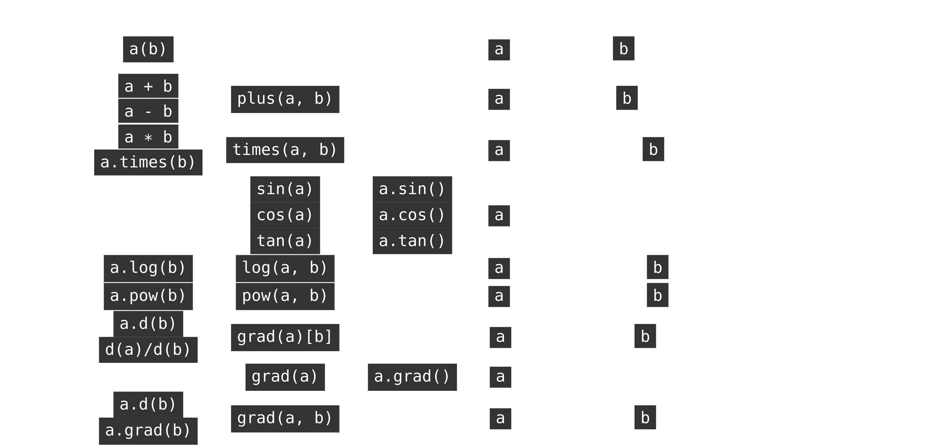
Compile-time shape safety
Notes:
\begin{tabular}{|c|c|c|c|l|}
\hline
\multicolumn{1}{|c|}{Math} & Infix & Prefix & Postfix & Operator Type Signature \\ \hline
\begin{tabular}{@{}c@{}}$\mathbf{\mathbf{A}}(\mathbf{\mathbf{B}})$\\$\mathbf{\mathbf{A}}\circ\mathbf{\mathbf{B}}$\end{tabular} & \tinline{a(b)} & & & $ ($\tinline{a}$: \mathbb{R}^{\tau}\rightarrow\mathbb{R}^{\pi}$, $\tinline{b}: \mathbb{R}^{\lambda} \rightarrow \mathbb{R}^{\tau}) \rightarrow (\mathbb{R}^{\lambda}\rightarrow \mathbb{R}^{\pi}) $ \\ \hline
$\mathbf{\mathbf{A}}\pm\mathbf{\mathbf{B}}$ & \begin{tabular}{@{}c@{}}\tinline{a + b}\\\tinline{a - b}\end{tabular} & \tinline{plus(a, b)} & & $ ($\tinline{a}$: \mathbb{R}^{\tau}\rightarrow\mathbb{R}^{\pi},~$\tinline{b}$: \mathbb{R}^{\lambda} \rightarrow \mathbb{R}^{\pi}) \rightarrow (\mathbb{R}^{?}\rightarrow \mathbb{R}^{\pi}) $ \\ \hline
$\mathbf{A} \mathbf{B}$ & \begin{tabular}{@{}c@{}}\tinline{a * b}\\\tinline{a.times(b)}\end{tabular} & \tinline{times(a, b)} & & $ ($\tinline{a}$: \mathbb{R}^{\tau}\rightarrow\mathbb{R}^{m \times n},~$\tinline{b}$: \mathbb{R}^{\lambda}\rightarrow\mathbb{R}^{n \times p}) \rightarrow (\mathbb{R}^{?}\rightarrow\mathbb{R}^{m \times p}) $ \\ \hline
% \begin{tabular}{@{}c@{}}$\frac{\mathbf{A}}{\mathbf{B}}$\\$\mathbf{A}\mathbf{B}^{-1}$\end{tabular} & \begin{tabular}{@{}c@{}}\tinline{a / b}\\\tinline{a.div(b)}\end{tabular} & \tinline{div(a, b)} & & $ ($\tinline{a}$: \mathbb{R}^{\tau}\rightarrow\mathbb{R}^{m \times n},~$\tinline{b}$: \mathbb{R}^{\lambda}\rightarrow\mathbb{R}^{p \times n}) \rightarrow (\mathbb{R}^{?}\rightarrow\mathbb{R}^{m \times p}) $ \\ \hline
% $\pm\mathbf{\mathbf{A}}$ & & \begin{tabular}{@{}c@{}}\tinline{-a}\\\tinline{+a}\end{tabular} & \begin{tabular}{@{}c@{}}\tinline{a.unaryMinus()}\\\tinline{a.unaryPlus()}\end{tabular} & $ ($\tinline{a}$: \mathbb{R}^{\tau}\rightarrow\mathbb{R}^{\pi}) \rightarrow (\mathbb{R}^{\tau}\rightarrow\mathbb{R}^{\pi}) $ \\ \hline
\begin{tabular}{@{}c@{}}sin(a)\\cos(a)\\tan(a)\end{tabular} & & \begin{tabular}{@{}c@{}}\tinline{sin(a)}\\\tinline{cos(a)}\\\tinline{tan(a)}\end{tabular} & \begin{tabular}{@{}c@{}}\tinline{a.sin()}\\\tinline{a.cos()}\\\tinline{a.tan()}\end{tabular} & $ ($\tinline{a}$: \mathbb{R}\rightarrow\mathbb{R}) \rightarrow (\mathbb{R}\rightarrow\mathbb{R}) $ \\ \hline
% $\ln(\mathbf{A})$ & & \begin{tabular}{@{}c@{}}\tinline{ln(a)}\\\tinline{log(a)}\end{tabular} & \begin{tabular}{@{}c@{}}\tinline{a.ln()}\\\tinline{a.log()}\end{tabular} & $ ($\tinline{a}$: \mathbb{R}^{\tau}\rightarrow\mathbb{R}^{m \times m}) \rightarrow (\mathbb{R}^{\tau}\rightarrow\mathbb{R}^{m \times m}) $ \\ \hline
$\log_b \mathbf{A}$ & \tinline{a.log(b)} & \tinline{log(a, b)} & & $ ($\tinline{a}$: \mathbb{R}^{\tau}\rightarrow\mathbb{R}^{m \times m},~$\tinline{b}$: \mathbb{R}^{\lambda}\rightarrow\mathbb{R}^{m \times m}) \rightarrow (\mathbb{R}^{?}\rightarrow\mathbb{R}) $ \\ \hline
$\mathbf{A}^{b}$ & \tinline{a.pow(b)} & \tinline{pow(a, b)} & & $ ($\tinline{a}$: \mathbb{R}^{\tau}\rightarrow\mathbb{R}^{m \times m},~$\tinline{b}$: \mathbb{R}^{\lambda}\rightarrow\mathbb{R}) \rightarrow (\mathbb{R}^{?}\rightarrow\mathbb{R}^{m \times m}) $ \\ \hline
% \begin{tabular}{@{}c@{}}$\sqrt{a}$\\$\sqrt[3]{a}$\end{tabular} & \begin{tabular}{@{}c@{}}\tinline{a.pow(1.0/2)}\\\tinline{a.root(3)}\end{tabular} & \begin{tabular}{@{}c@{}}\tinline{a.pow(1.0/2)}\\\tinline{a.root(3)}\end{tabular} & \begin{tabular}{@{}c@{}}\tinline{a.sqrt()}\\\tinline{a.cbrt()}\end{tabular} & $ ($\tinline{a}$: \mathbb{R}^{\tau}\rightarrow\mathbb{R}^{m \times m}) \rightarrow (\mathbb{R}\rightarrow\mathbb{R}^{m \times m}) $ \\ \hline
\begin{tabular}{@{}c@{}}$\frac{da}{db}$, $\frac{\partial{a}}{\partial{b}}$\\$D_{b}a$\end{tabular} & \begin{tabular}{@{}c@{}}\tinline{a.d(b)}\\\tinline{d(a)/d(b)}\end{tabular} & \tinline{grad(a)[b]} & & $ \big($\tinline{a}$: C(\mathbb{R}^{\tau}\rightarrow\mathbb{R})$, $\tinline{b}: C(\mathbb{R}^{\lambda}\rightarrow\mathbb{R})\big) \rightarrow (\mathbb{R}^{?}\rightarrow\mathbb{R}) $ \\ \hline
$\nabla a$ & & \tinline{grad(a)} & \tinline{a.grad()} & $ \big($\tinline{a}$: C(\mathbb{R}^{\tau}\rightarrow\mathbb{R})\big) \rightarrow (\mathbb{R}^{\tau}\rightarrow\mathbb{R}^{\tau}) $ \\ \hline
$\nabla_{\mathbf{B}} a$ & \begin{tabular}{@{}c@{}}\tinline{a.d(b)}\\\tinline{a.grad(b)}\end{tabular} & \tinline{grad(a, b)} & & $ \big($\tinline{a}$: C(\mathbb{R}^{\tau}\rightarrow\mathbb{R})$, $\tinline{b}: C(\mathbb{R}^{\lambda}\rightarrow\mathbb{R}^{n})\big) \rightarrow (\mathbb{R}^{?}\rightarrow\mathbb{R}^{n}) $ \\ \hline
\end{tabular}

Slide 35
Lazy Composition
class Composition<X : Fun<X>>(val fn: Fun<X>, val bindings: Bindings<X>) : Fun<X>() { val evaluate by lazy { apply() } override val sVars: Set<Var<X>> by lazy { evaluate.sVars } fun Fun<X>.apply(): Fun<X> = bindings.sMap.getOrElse(this) { when (this) { is Var -> this is Const -> this is Prod -> left.apply() * right.apply() is Sum -> left.apply() + right.apply() is Power -> base.apply() pow exponent.apply() is Derivative -> df().apply() is Composition -> fn.apply().apply() } } }
Notes:
Facilitates change of variables

Slide 36
Dataflow graphs
Kraphviz by Stefan Niederhauser: https://github.com/nidi3/graphviz-java#kotlin-dsl

Slide 37
What can be derived?

Slide 38

Optimization is just one perspective
“With four parameters I can fit an elephant, and with five I can make him wiggle his trunk.”
–John Von Neumann
Notes:
Optimization provides a narrow perspective on the sorts of applications which automatic differentiation affords.

Slide 39
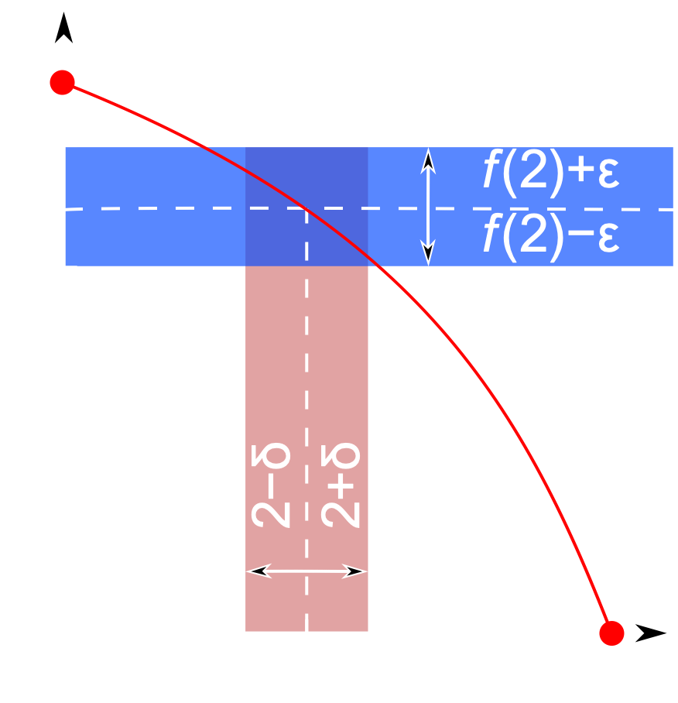
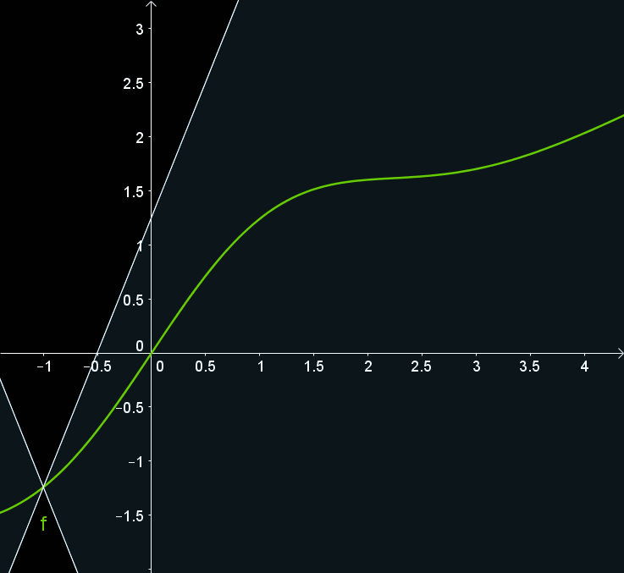
Continuity: bounded differences

Slide 40
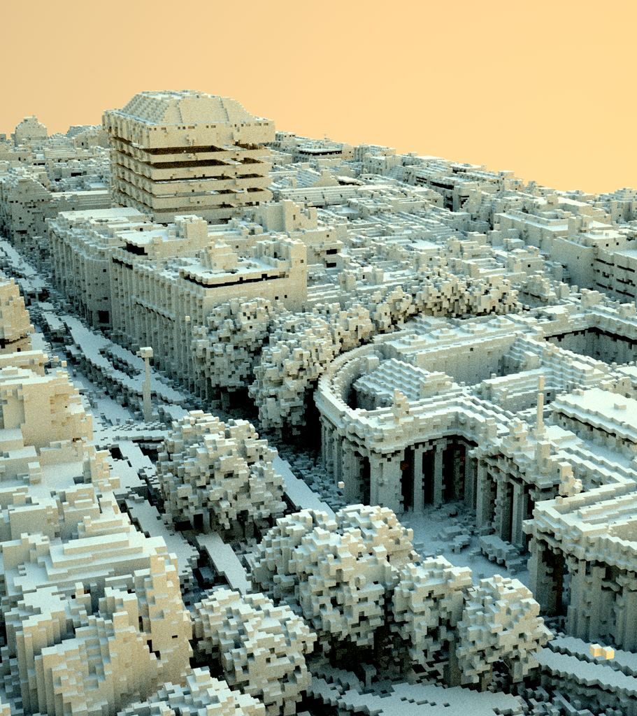

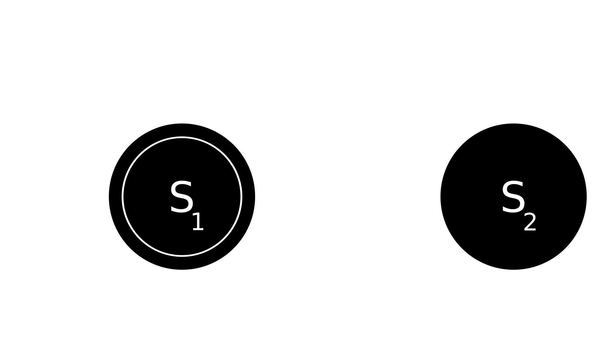
Computer science
The world is discrete
Point Cloud Voxelization
(Tommy Hinks)

Slide 41

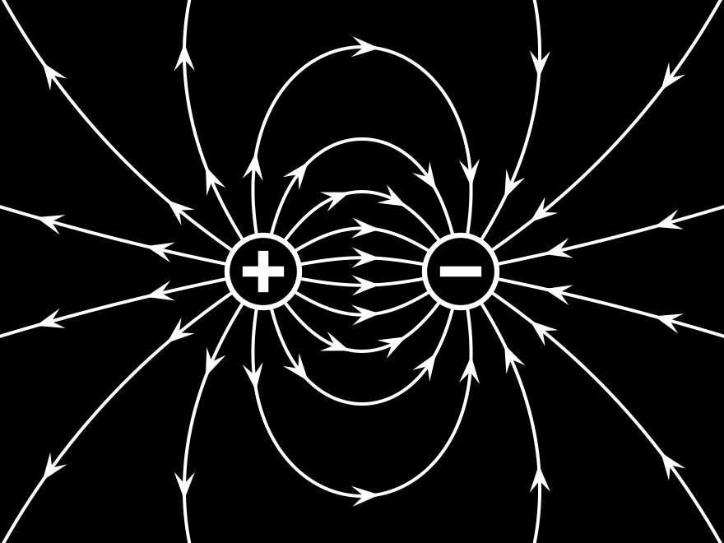
Physicists
World is differentiable
Hamiltonian mechanics
Wave equation
Pendulum with friction

Slide 42
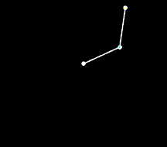
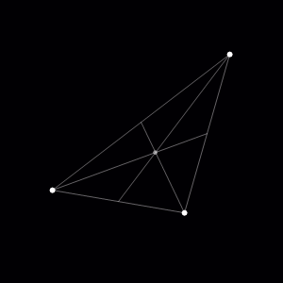
Nonlinear dynamics: no closed form solution
Double Pendulum
Three Body Orbit
https://en.wikipedia.org/wiki/Double_pendulum
https://en.wikipedia.org/wiki/Three-body_problem
Notes:
No closed form analytical solution: can’t plugin in initial state and duration and get the state out – must evolve the system using instantaneous rates of change.
Instantaneous rates of changes for coupled bodies.

Slide 43
How do I derive in Kotlin?
Gottfried Wilhelm Leibniz

Slide 44
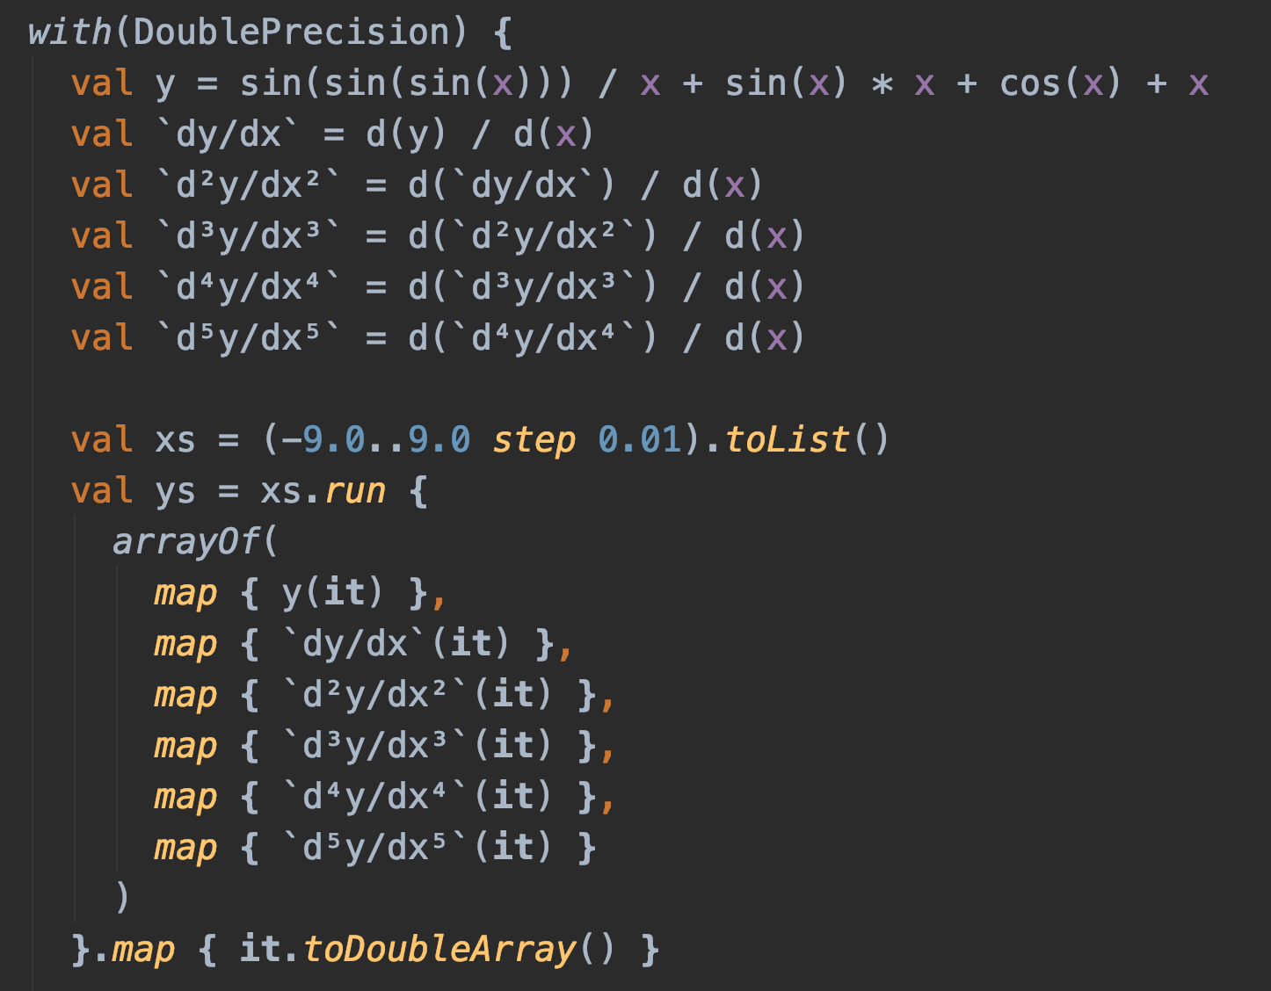
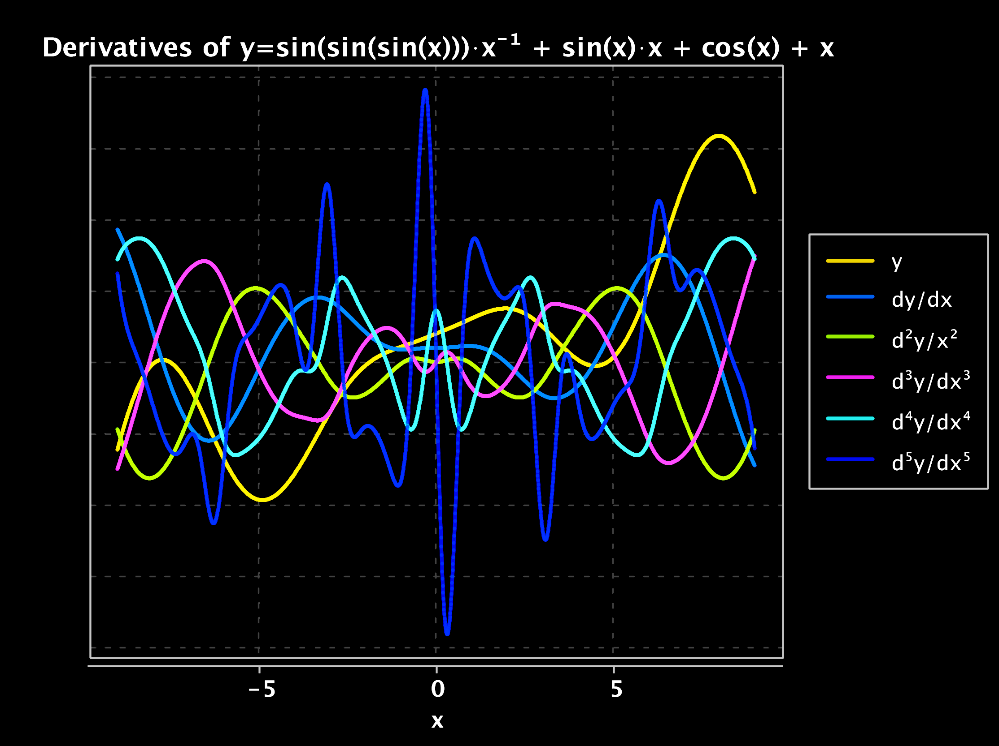
Arbitrarily high order differentiation

Slide 45
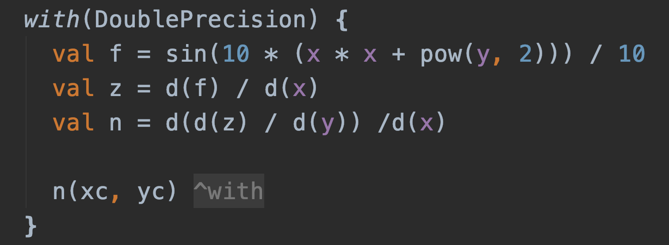
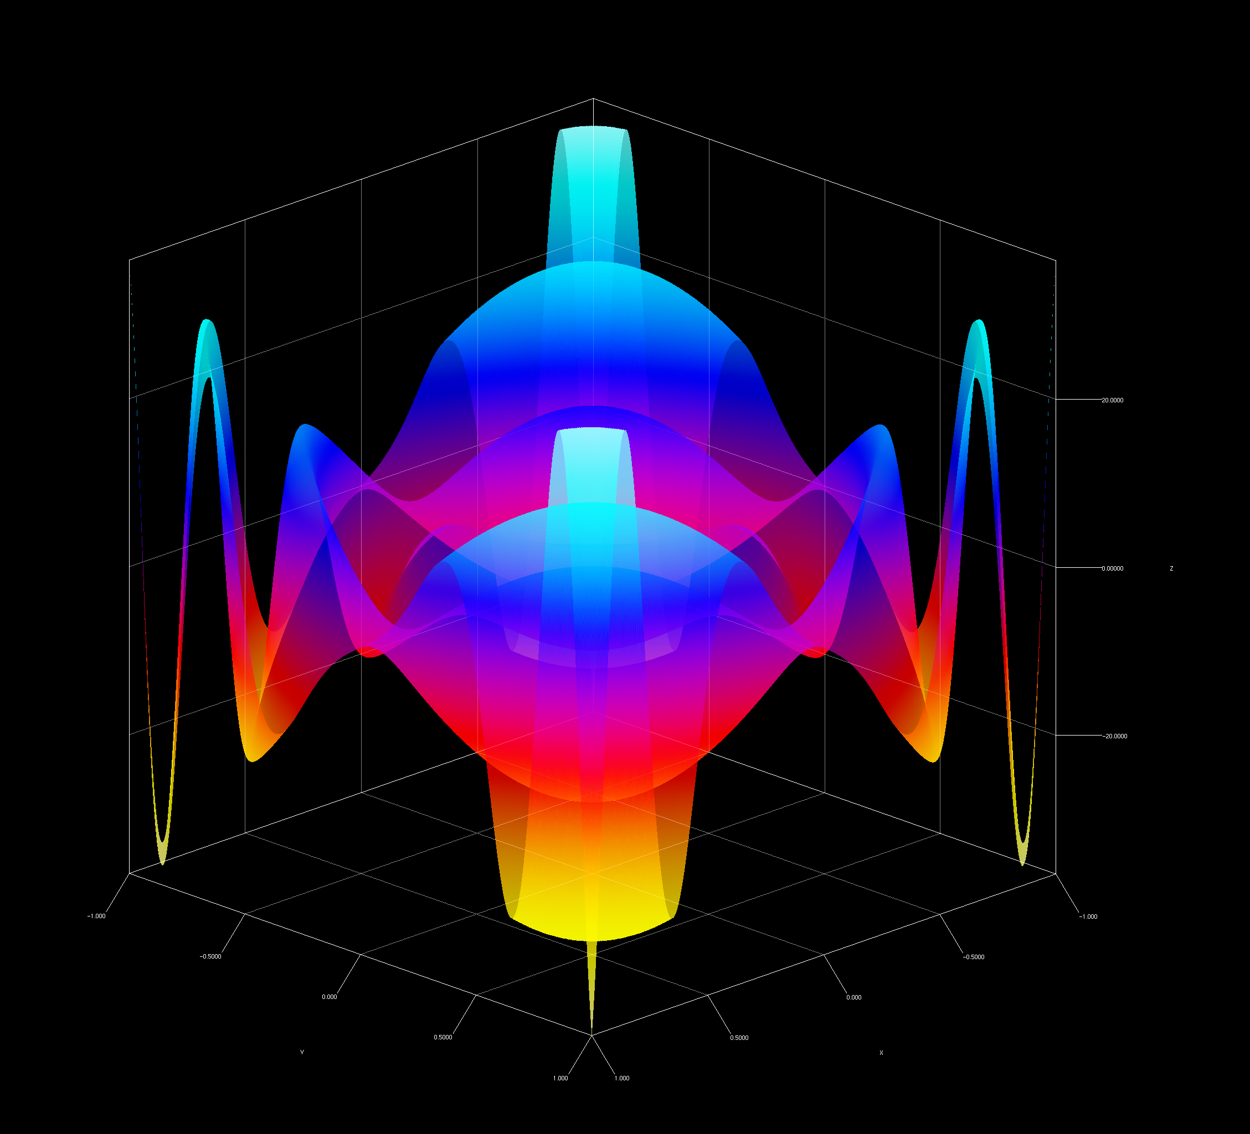
Arbitrarily high order differentiation

Slide 46
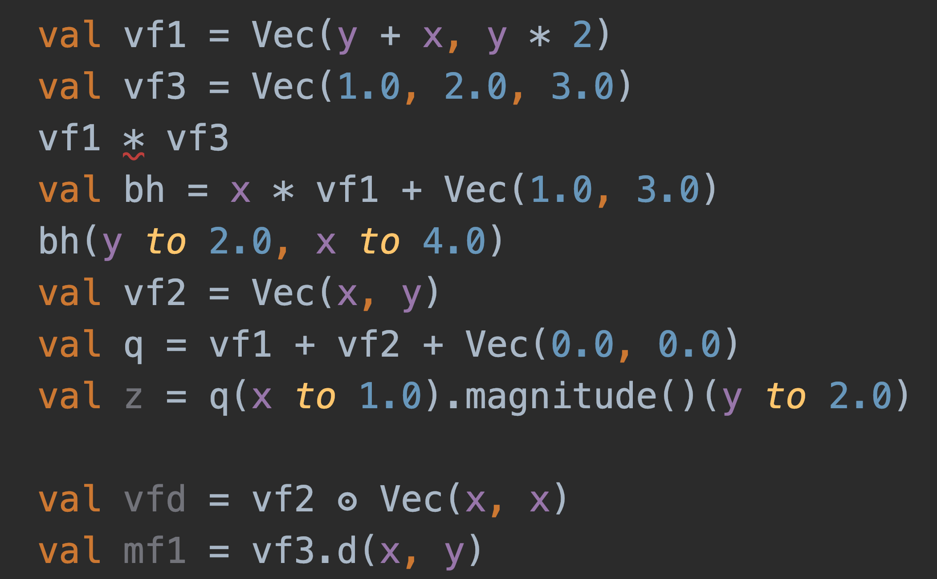
Type safe vector manipulation

Slide 47
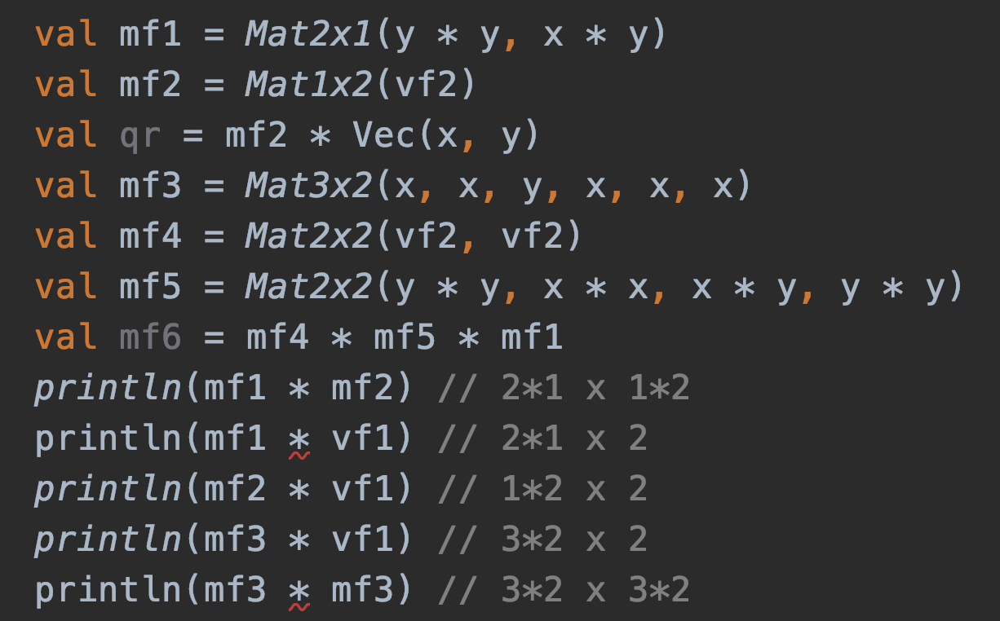
Type safe matrix manipulation

Slide 48
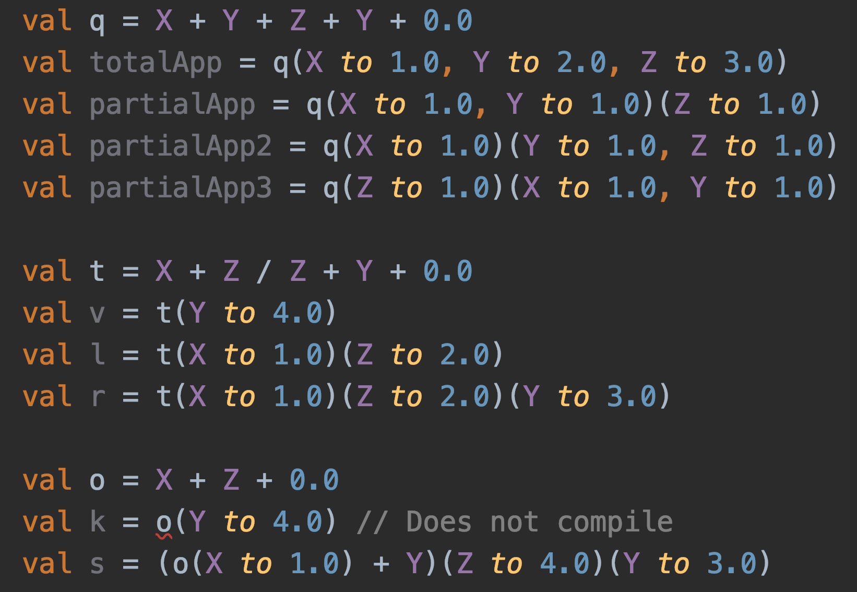
Type safe currying (experimental)

Slide 49
What’s the difference?

Slide 50
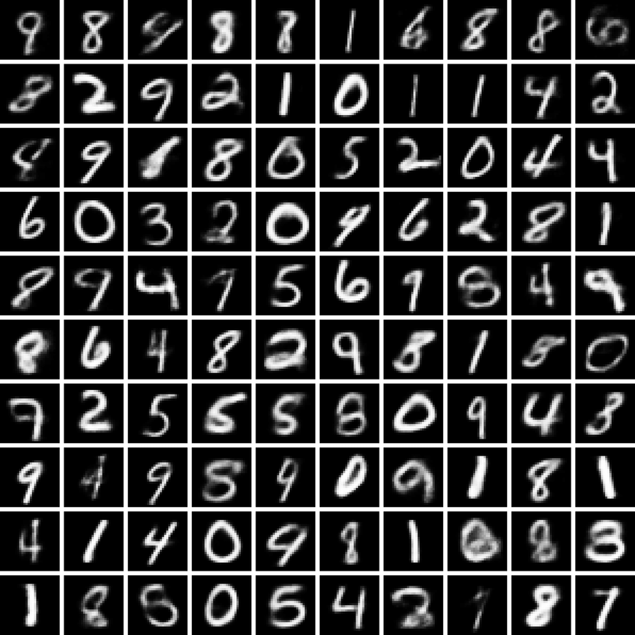
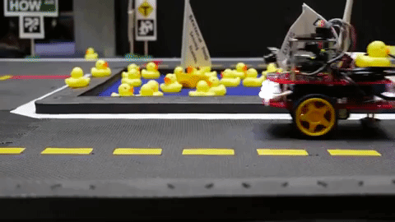
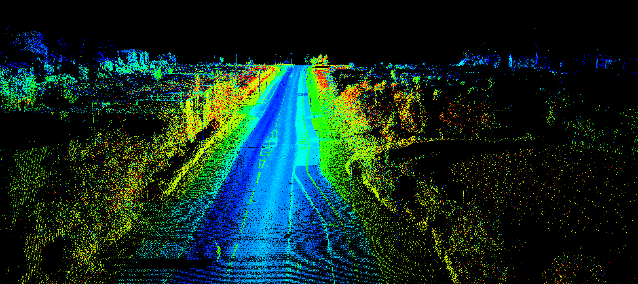
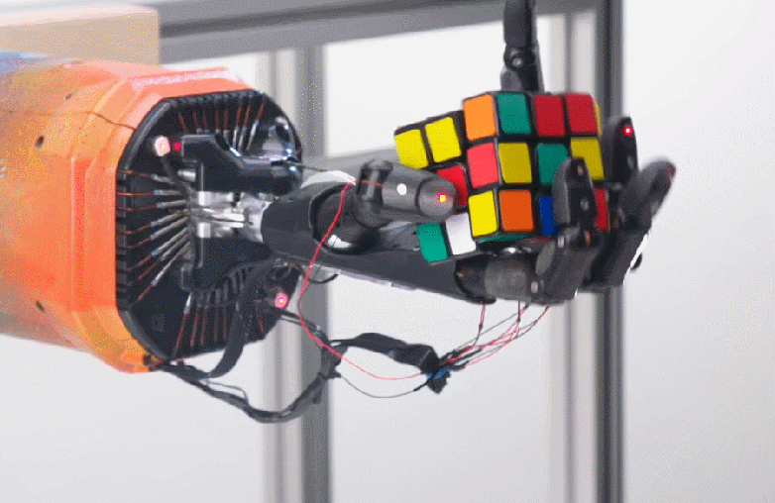
Code is the interface

Slide 51
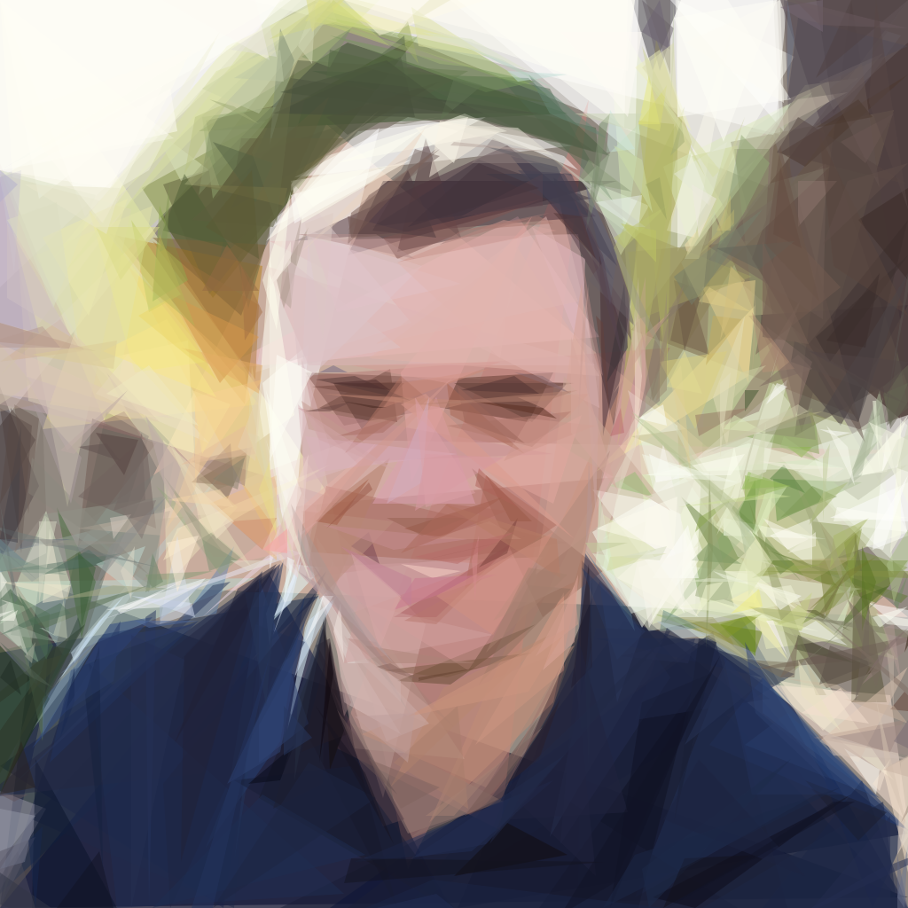
Differentiable Programming
“Neural networks are not just another classifier, they represent the beginning of a fundamental shift in how we write software.”
-Andrej Karpathy

Slide 52
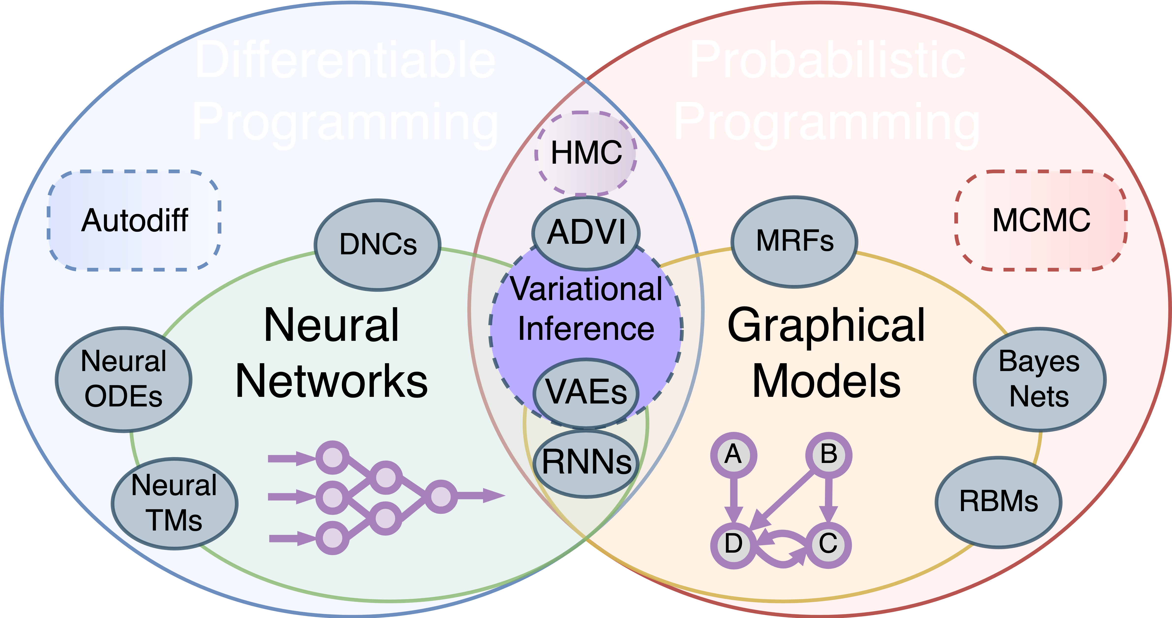
Why do derivatives matter?

Slide 53
Learn more at:
Kotlin∇
kg.ndan.co

Slide 54
Interested in mathematical abstractions?
KMath
github.com/mipt-npm/kmath

Slide 55




Special Thanks
Liam Paull
Michalis Famelis
Jin Guo

Slide 56
@breandan

